Slide 1
Enrollment Prediction Database
CODE WARRIORS

Slide 2
INTRODUCTION
This database project proposal focuses on creating an enrollment projections for the future year and to update those projections annually.

Slide 3
TECHNOLOGIES USED
SQL - MS SQL Server, MS SQL Server Management Studio
NoSQL - MongoDB, MacOS Terminal

Slide 4
SQL : Tables
We have a total of 6 tables with 2 schemas : University and Student. These tables are:
Profiles (Students)
Education (Students)
TestScores (Students)
Application (Students)
Schools (University)
Majors (University)

Slide 5
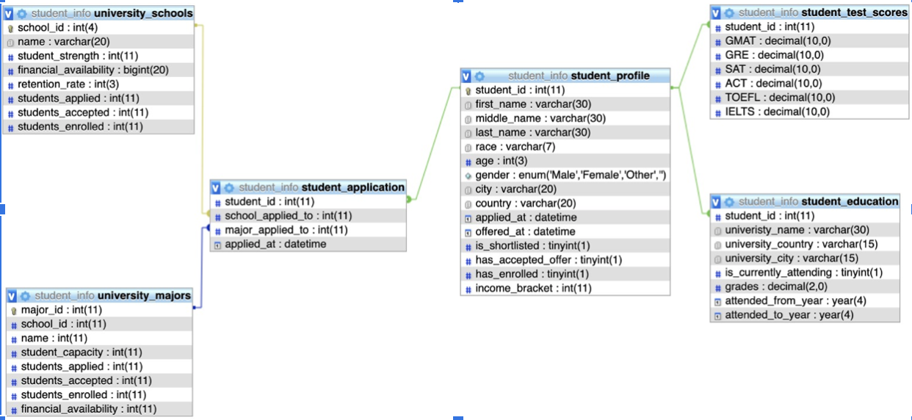
SQL : Tables & Relationships

Slide 6
TRIGGERS
We have implemented a trigger on the ‘University.Majors’ table for whenever the count of student who have applied, got acceptance or have enrolled updates, the trigger updates the count for the corresponding School for that major as well.
This supports the data integrity of the database.

Slide 7
TRIGGERS
Now you will see a small demo showing the working of the trigger

Slide 8
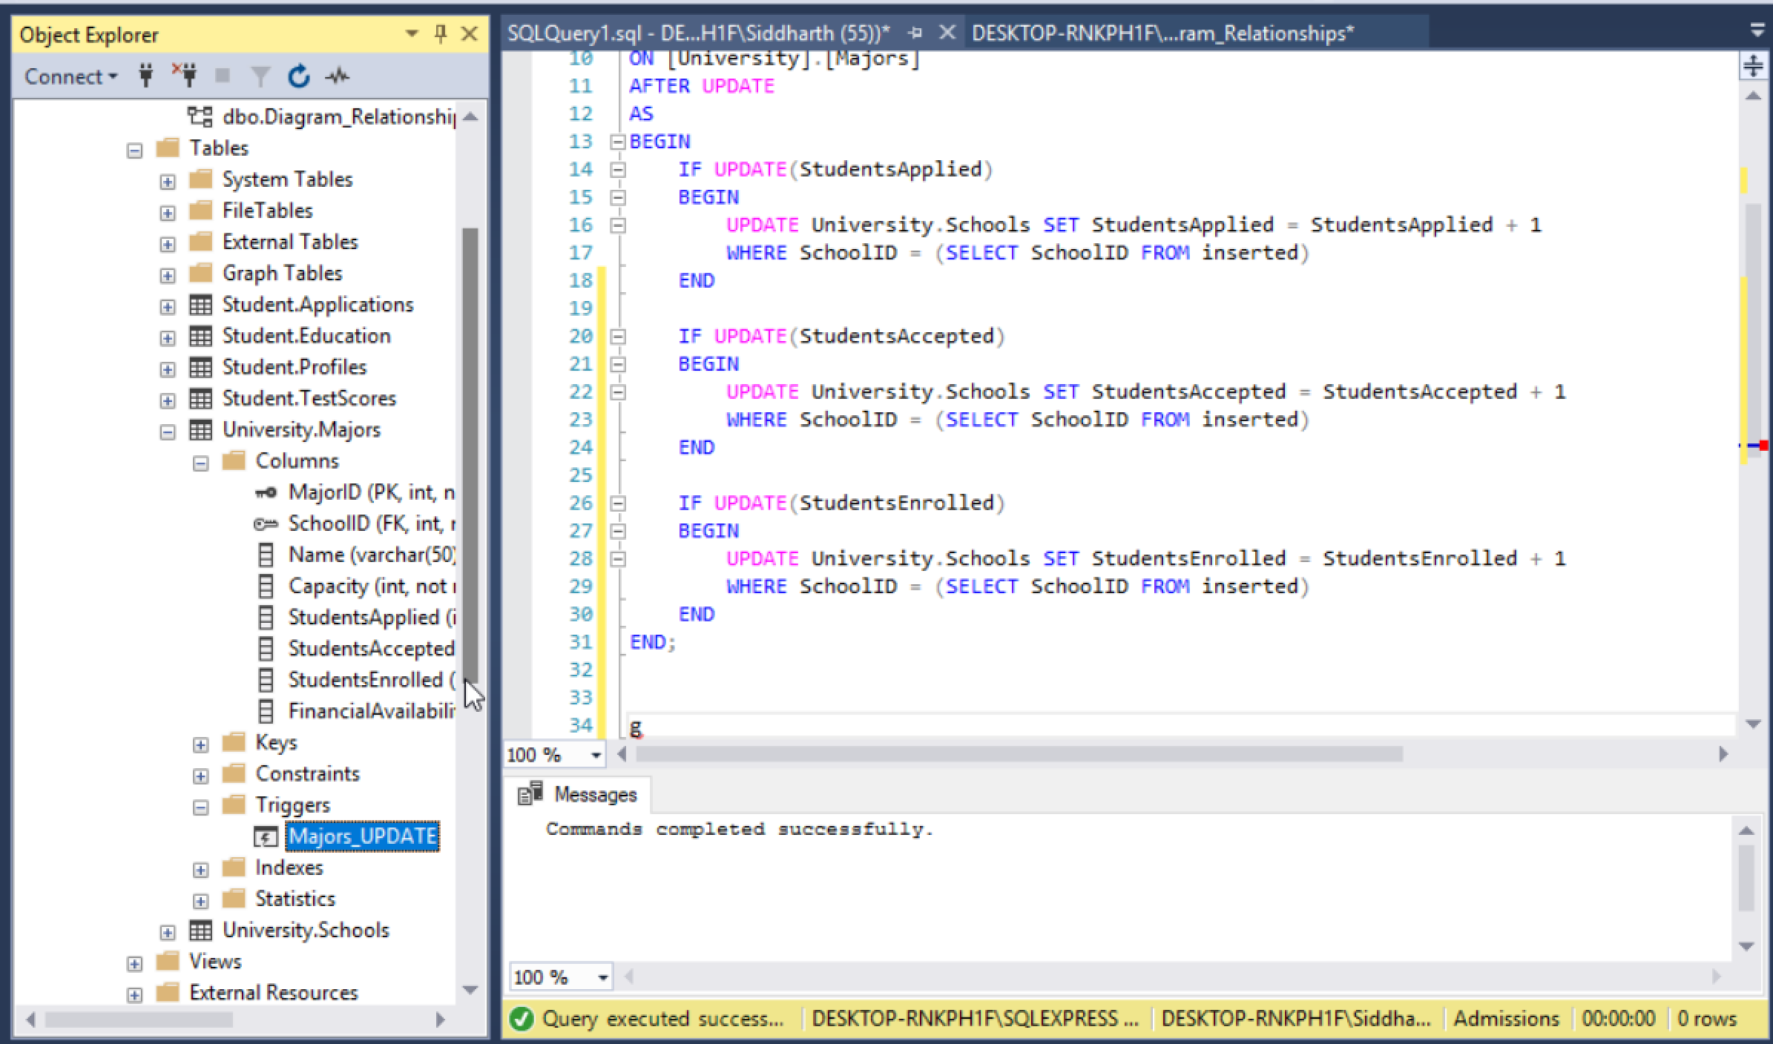

Slide 9
STORED PROCEDURES
The first stored procedure fetches the student profiles of individuals who have applied. This will be sorted by the application receival date.
This is a simple list of the university majors along with their corresponding colleges.

Slide 10
Stored Procedure Demo
Now you will see a small demo showing the working of the Stored Procedure.

Slide 11
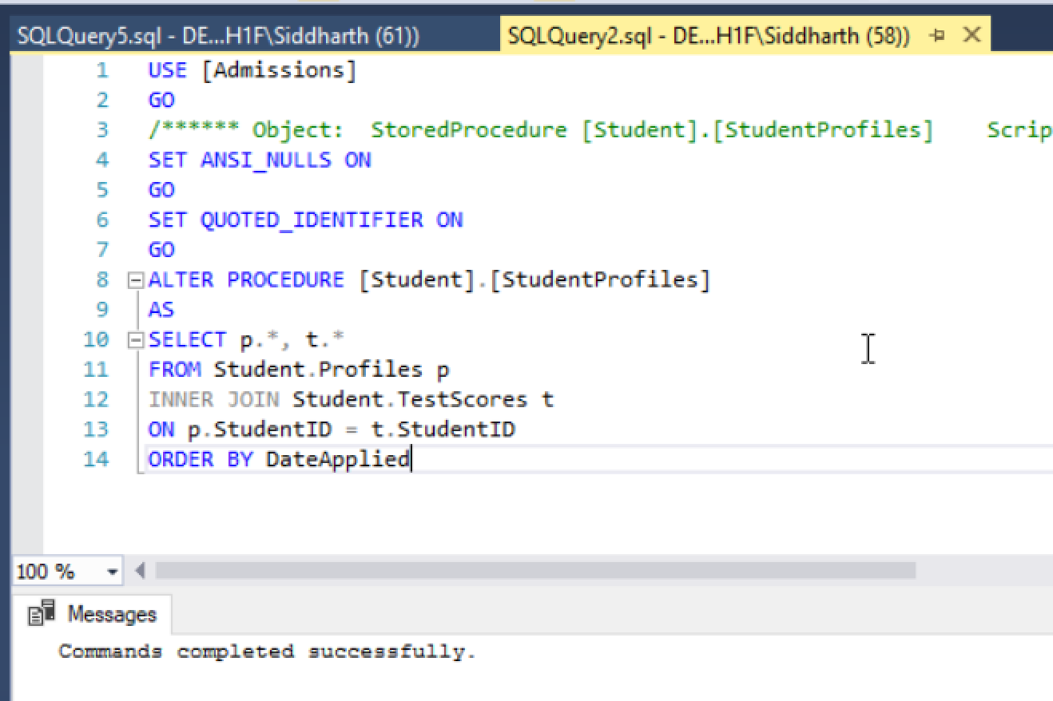

Slide 12
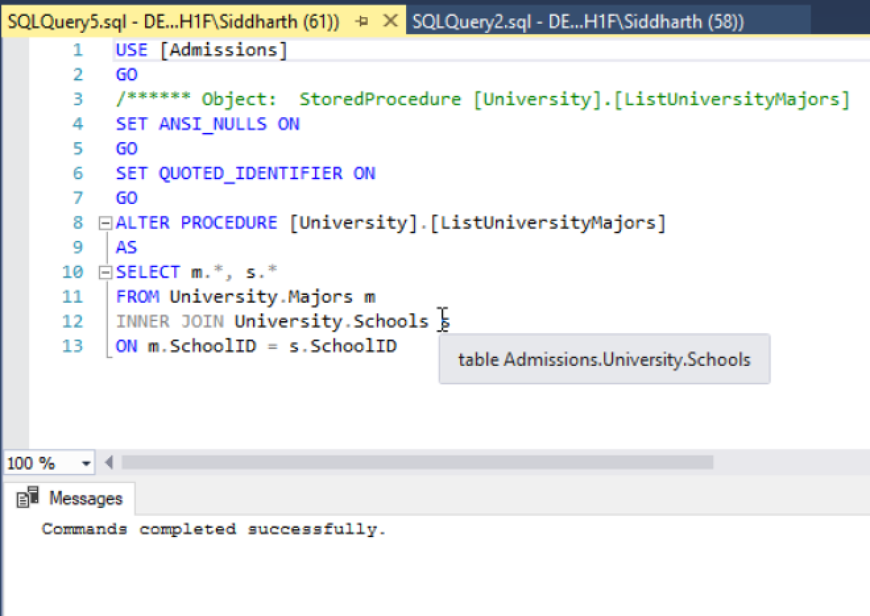

Slide 13
Cursors
Cursors help us to perform data manipulations on each row retrieved using a SELECT statement.
We have also added a cursor to fetch all the rows of student names, their ids and the major name to which they have applied to.

Slide 14
Cursors - Demo
Now we will run the program to show the working of Cursor code.
Due to scarcity of data, we have only one row to show as a result.

Slide 15
NoSQL - MongoDB
Database - ‘admissions’
Collections:
University (includes document containing the schools and their respective majors)
Applications (includes the student details such as profile, education, test scores and application details)

Slide 16
NoSQL vs SQL : Structure Comparison
Schema : Student
For SQL, the student details are divided between 4 tables, ‘profile’ being the primary and the referenced table using the ‘StudentID’.
For NoSQL, a single student profile is contained inside one document i.e., the combination of four tables used in SQL is in one single document separated by different keys.

Slide 17
NoSQL vs SQL : Structure Comparison
Schema : University
For SQL, the university schools and majors are listed under 2 different tables and linked with the ‘SchoolID’ as the primary key for table ‘Schools’ and as foreign key for table ‘Majors’.
For NoSQL, the university schools are stored in one document and the corresponding majors are stored as an embedded array of objects inside the corresponding schools.

Slide 18
NoSQL vs SQL : Querying & Data Retrieval
Objective: Fetching Shortlisted Student Profiles
SQL:
SELECT p.*, t.*
FROM Student.Profiles p
INNER JOIN Student.TestScores t
ON p.StudentID = t.StudentID
WHERE IsShortlisted = 1
ORDER BY StudentID
NoSQL:
db.applications.find({"profile.IsShortlisted":1}).sort({"StudentID":1}).pretty()
The query in NoSQL does not use any ‘join’ since the required profile details are stored inside one single document. The ‘ORDER BY’ clause form SQL is similar to the ‘.sort()’ function of Mongo. We can add more additional tables to the SQL query but it may cause data redundancy since a single student may have multiple entries in the ‘education’ table.

Slide 19
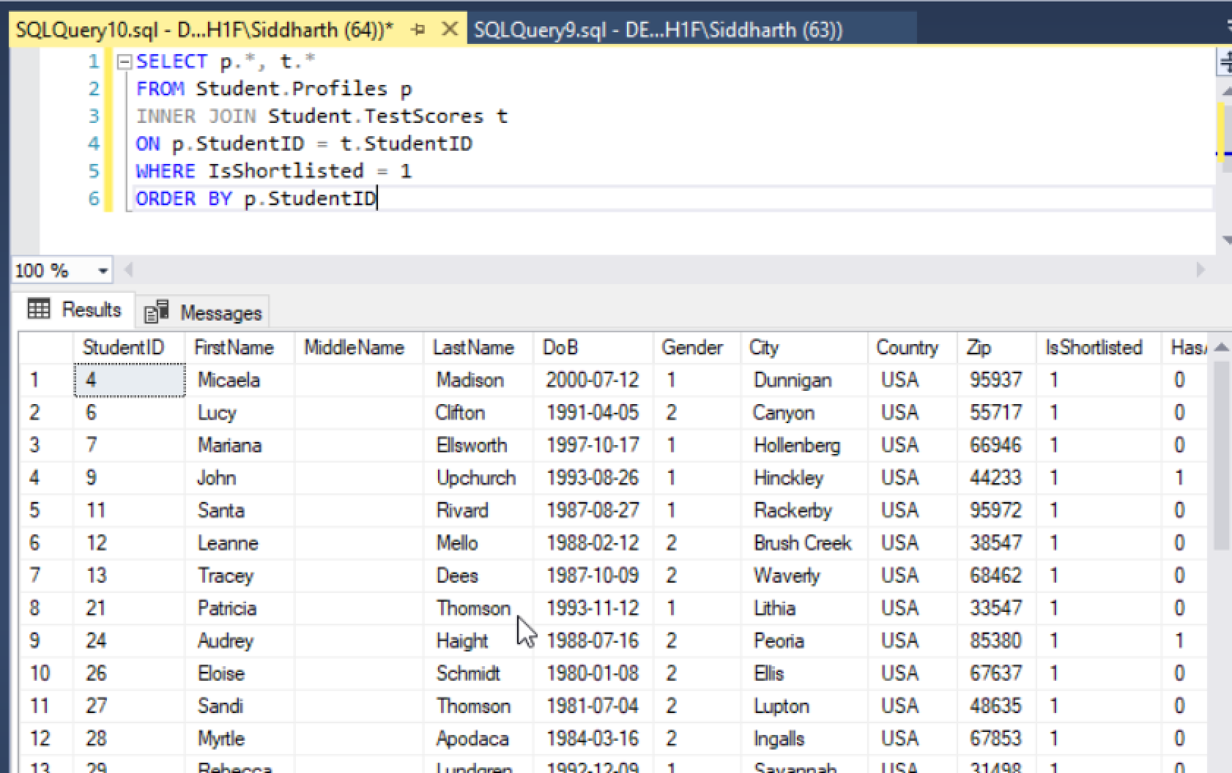
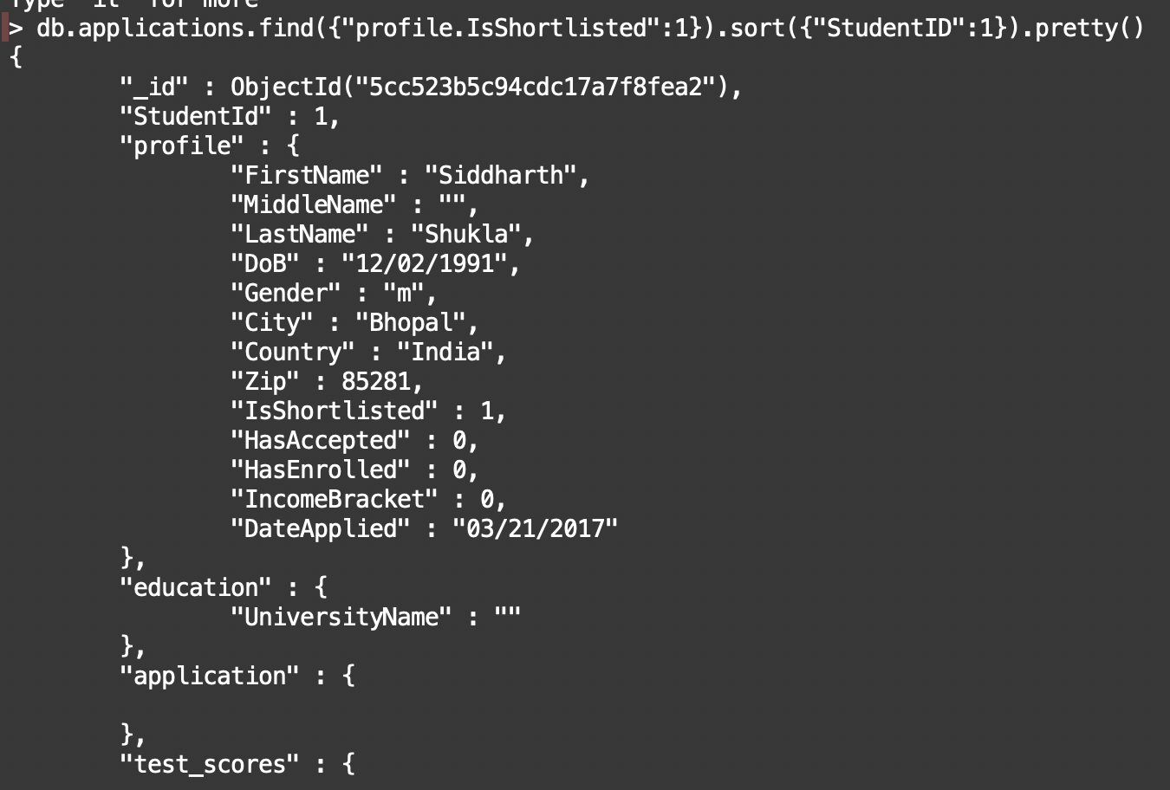
NoSQL vs SQL : Querying & Data Retrieval

Slide 20
DIFFERENCE BETWEEN SQL AND NoSQL
NoSQL Advantages
More Flexibility in storing data
We can get any data of the student through small queries
NoSQL Disadvantages
We need to specify keys for getting individual data

Slide 21
CONCLUSION
This database can be resourceful to college administrators and allow them to allocate resources effectively. We have run the scripts on Data we have generated.

Slide 22
THANK YOU
Code Warriors OUT!!
-GautamDEV, Rounak, Siddharth

